Slide 1

Recpe Finder 2000
An app by Rodney

Slide 2
Ever want to cook but cant decide?
Recipe finder 2000 ™ is here to help!
Built on the basis of a personal cookbook, this app utilises one of the most extensive cullinary API’s
It works by simply giving the user access to the wealth of information stored in the spoontacular service and provides a starter apiKey and instructions on how to update the api key in the app

Slide 3
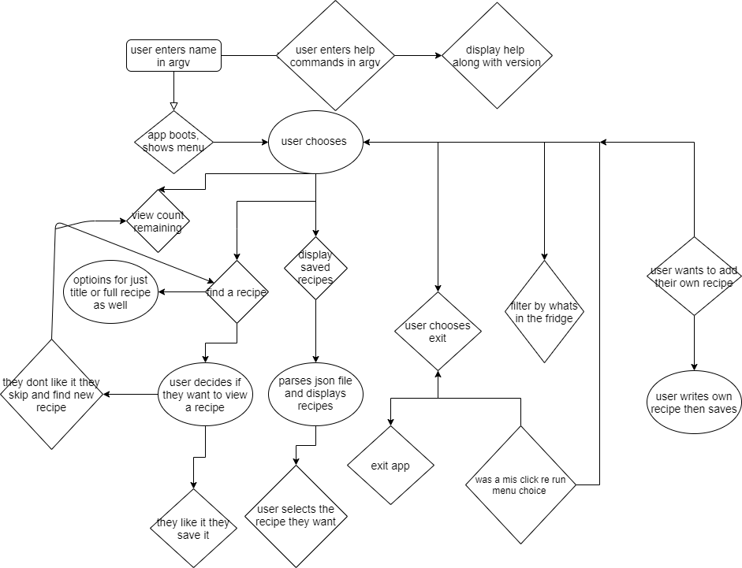

Slide 4
Logic
- The menu is a loop
- The recipes are save to json
- recipes are then searched by using array methods
- recipes are written in a terminal table
- hopefully a nice ui

Slide 5
Design process!
Steps:
Think of a problem that you have
Think of how you might fix it
Think of how to make it fit the brief
Think of how to make it “user friendly”
???
$$PROFIT$$

Slide 6
But how?
This is a question i found myself asking a lot, seriously i don’t exactly know why it was so hard, i mean i just had to figure it out right?
One thing i learned is while codewars is fun it’s a lot harder coming up with an idea.

Slide 7
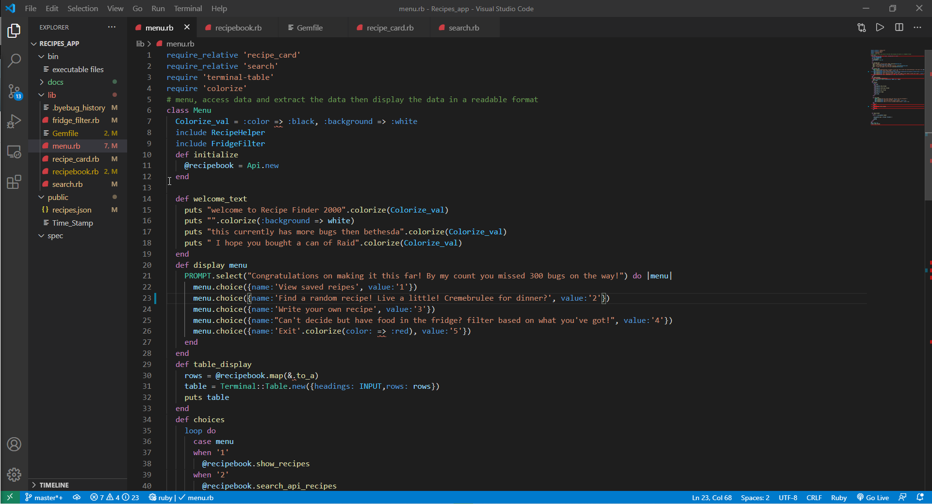
Time for some code!
Menu file

Slide 8
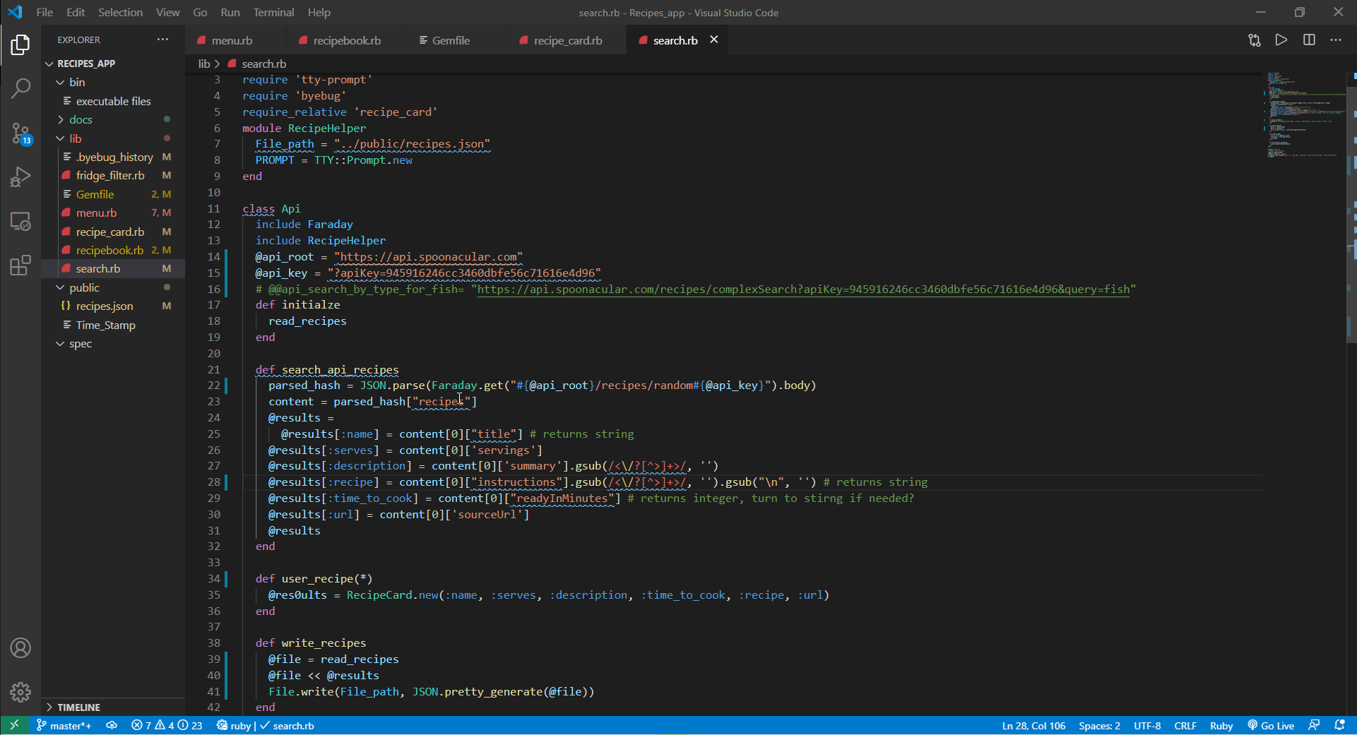
Time for some code!
search file

Slide 9
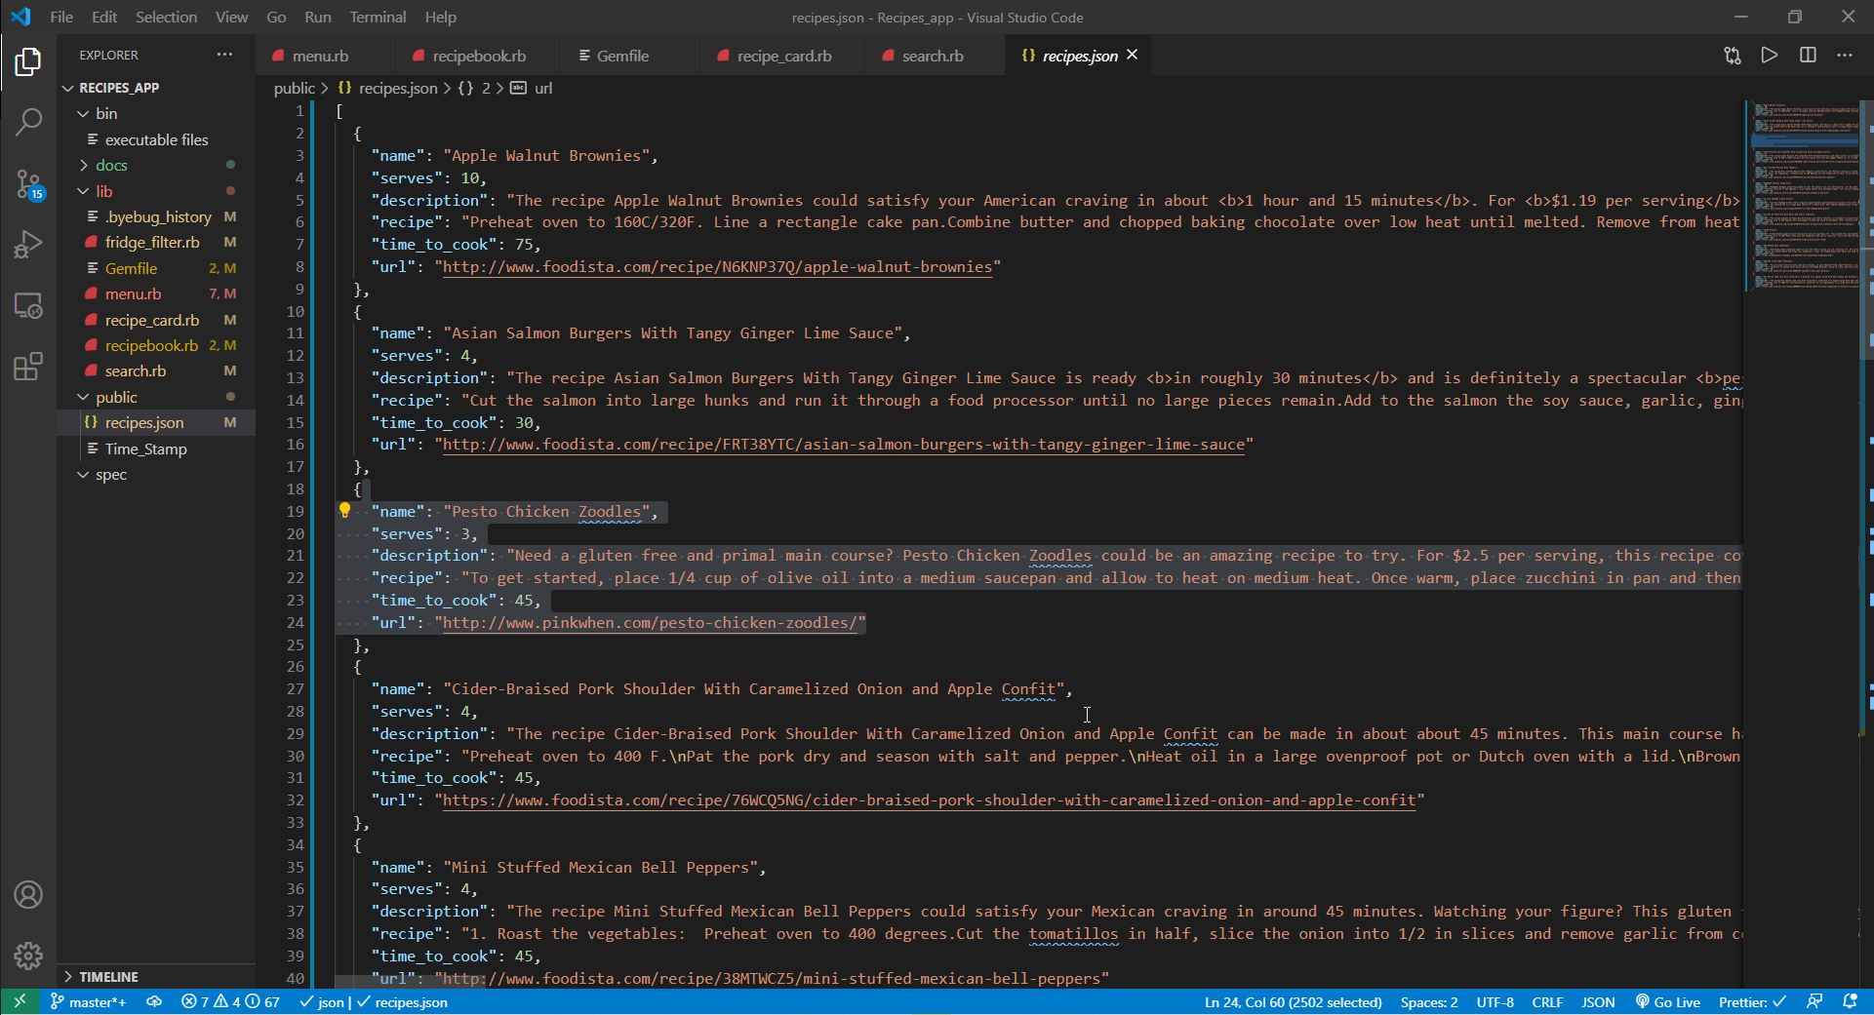
Time for some code!
Recipe Json file

Slide 10
Right so how does it work?
First of in the menu the landing page a bunch of strings pop up with the standard “hi how are you?” fanfare and i added a bunch of color to the bleak terminal to liven things up.
Then the magic happens the app queries the spoonacular api which then returns a json string that gets converted and read then takes the bits the user needs to see and spits them out on the app interface, at least in theory….
The user can also add recipes if they like to there own personal recipe book in the same format and read them whenever they like

Slide 11
All these gems and i don’t even have a chaos emerald.
The gems i used were pretty basic and rather easy to manipulate:
Tty-prompt for the interface Faraday for the api access
Terminal-table for the layout of the app just to clean things up a bit
Colorize because who doesnt like more color in their day?

Slide 12
#Thestruggleisreal
First off i decided to make this app and spent maybe a day working on it before i decided i would just make a game instead, that took maybe 2-3 days to complete and it’s pretty solid. But as it turns out the game used a gem that wasn't so much “allowed” so on monday morning i found out i couldnt use it.
What you’re seeing here is the product of about 4 hours sleep over two days in an attempt to rush out a finished product, please be gentle.

